Slide 1

Dr. Timothy Lisante
Superintendent
tlisant@schools.nyc.gov
Pathways of Possibility Conference
CUNY Baruch College
February 27, 2013

Slide 2
District 79 Portfolio of Programs
Youth Justice Education
(Involuntary Settings)
Programmatic Areas
GED
Career & Technical Education
Services for Student Parents
Educational Programs for Students in Drug Treatment
Correctional Education
Schools & Programs
GED Plus
Co Op Tech
LYFE
ReStart Academy
East River Academy
STEP
Phoenix Academy
Passages Academy
Educational Pathways/ Challenges / Promising Practices
2

Slide 3
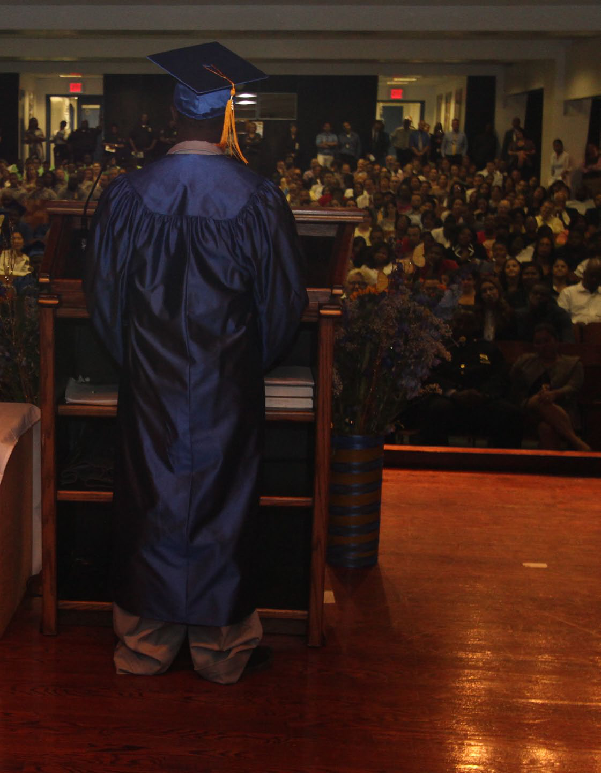
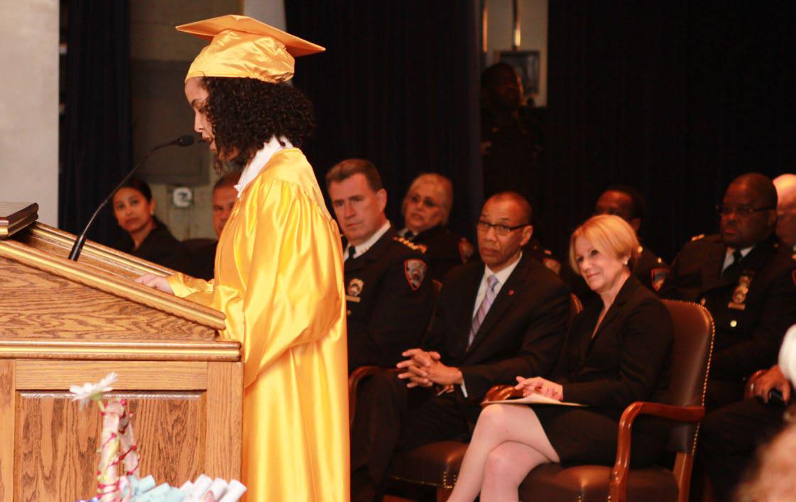
EAST RIVER ACADEMY – Rikers Graduation 2012

Slide 4
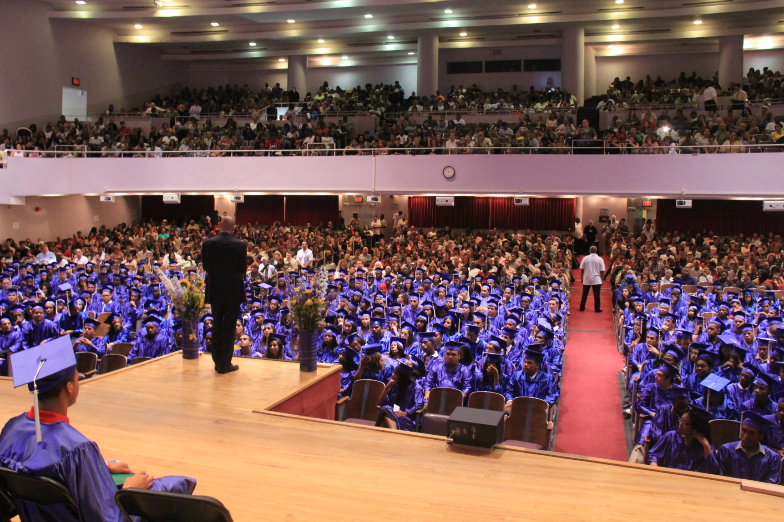
GED PLUS Graduation

Slide 5

Critical Partnerships for D79 Programs that serve Court-Involved Students
  City Agencies:
  New York City Police Department/School Safety
  Department of Probation
  ACS/Division of Youth and Family Justice
  Department of Health and Mental Hygiene
  Department of Youth and Community Development
  Department of Correction
  Interagency Committees/Networks
  NYC Juvenile Justice Advisory Committee
  School Justice Taskforce
  Alcohol/Substance Abuse Provider’s (ASAP) Youth Committee
  ICC Court-Involved Youth Working Group
  Re-Entry Education Network

Slide 6
D79 Advocacy Solutions
Intervention
Re-Entry Support
Home School Re-entry Process allows students who transition out of ERA and Passages to return to the their home school’s register immediately
Adolescent Behavioral Learning Experience (ABLE) is a partnership between DOE, DOC and the Osborne Association to support ERA students in reducing the likelihood of re-incarceration
DOE Court Liaisons provide current and applicable information that supports court-involved students in achieving their educational goals
Back on Track (collaboration with the District Attorney’s Office) and Outreach Academy are Re-Start programs that serve as alternatives for overage middle school students. GED classes in 3 different NY courts
Close to Home initiative expanded Passages Academy to support students in building social and emotional and academic skills. Close to Home impacts youth placed by the Family Court in ACS custody.
Referral Centers for High School Alternatives connect students who have had an interruption in their studies to alternative education program
Transition Counselors at ERA and Passages prepare student for their return to the community and connect students with no home school to Referral Centers
Specially trained Probation Officers for 16-17 year olds

Slide 7
Current Initiatives for Students who are Court-Involved
Intervention
PEAK program is a school based diversion program in collaboration with the Department of Probation which will provide support and programming including robust after-school and summer offerings
Re-Entry Support
Plan to Succeed NYC will serve as an electronic portfolio and individual learning plan that will help Passages and ERA students stay on a pathway to graduation and plan for transition
Enhance options for Overage Middle School students (Bx/ Man)
Transition Coaches will serve as community-based support to assist in re-entry into home schools
Friends of Island Academy Initiative will enhance services for 16-year-olds at ERA
Cross-over youth pre-release planning initiative will be a collaboration between ACS and the DOE to support students on Rikers who are also ACS-involved

