Slide 1
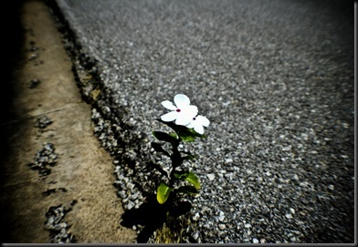
Resilience and the Community Mentoring Approach to GED and College Completion
Future Now / I.M.P.A.C.T
Improving My Progress at College Today
National College Transition Network
Friday, November 9th 2012

Slide 2
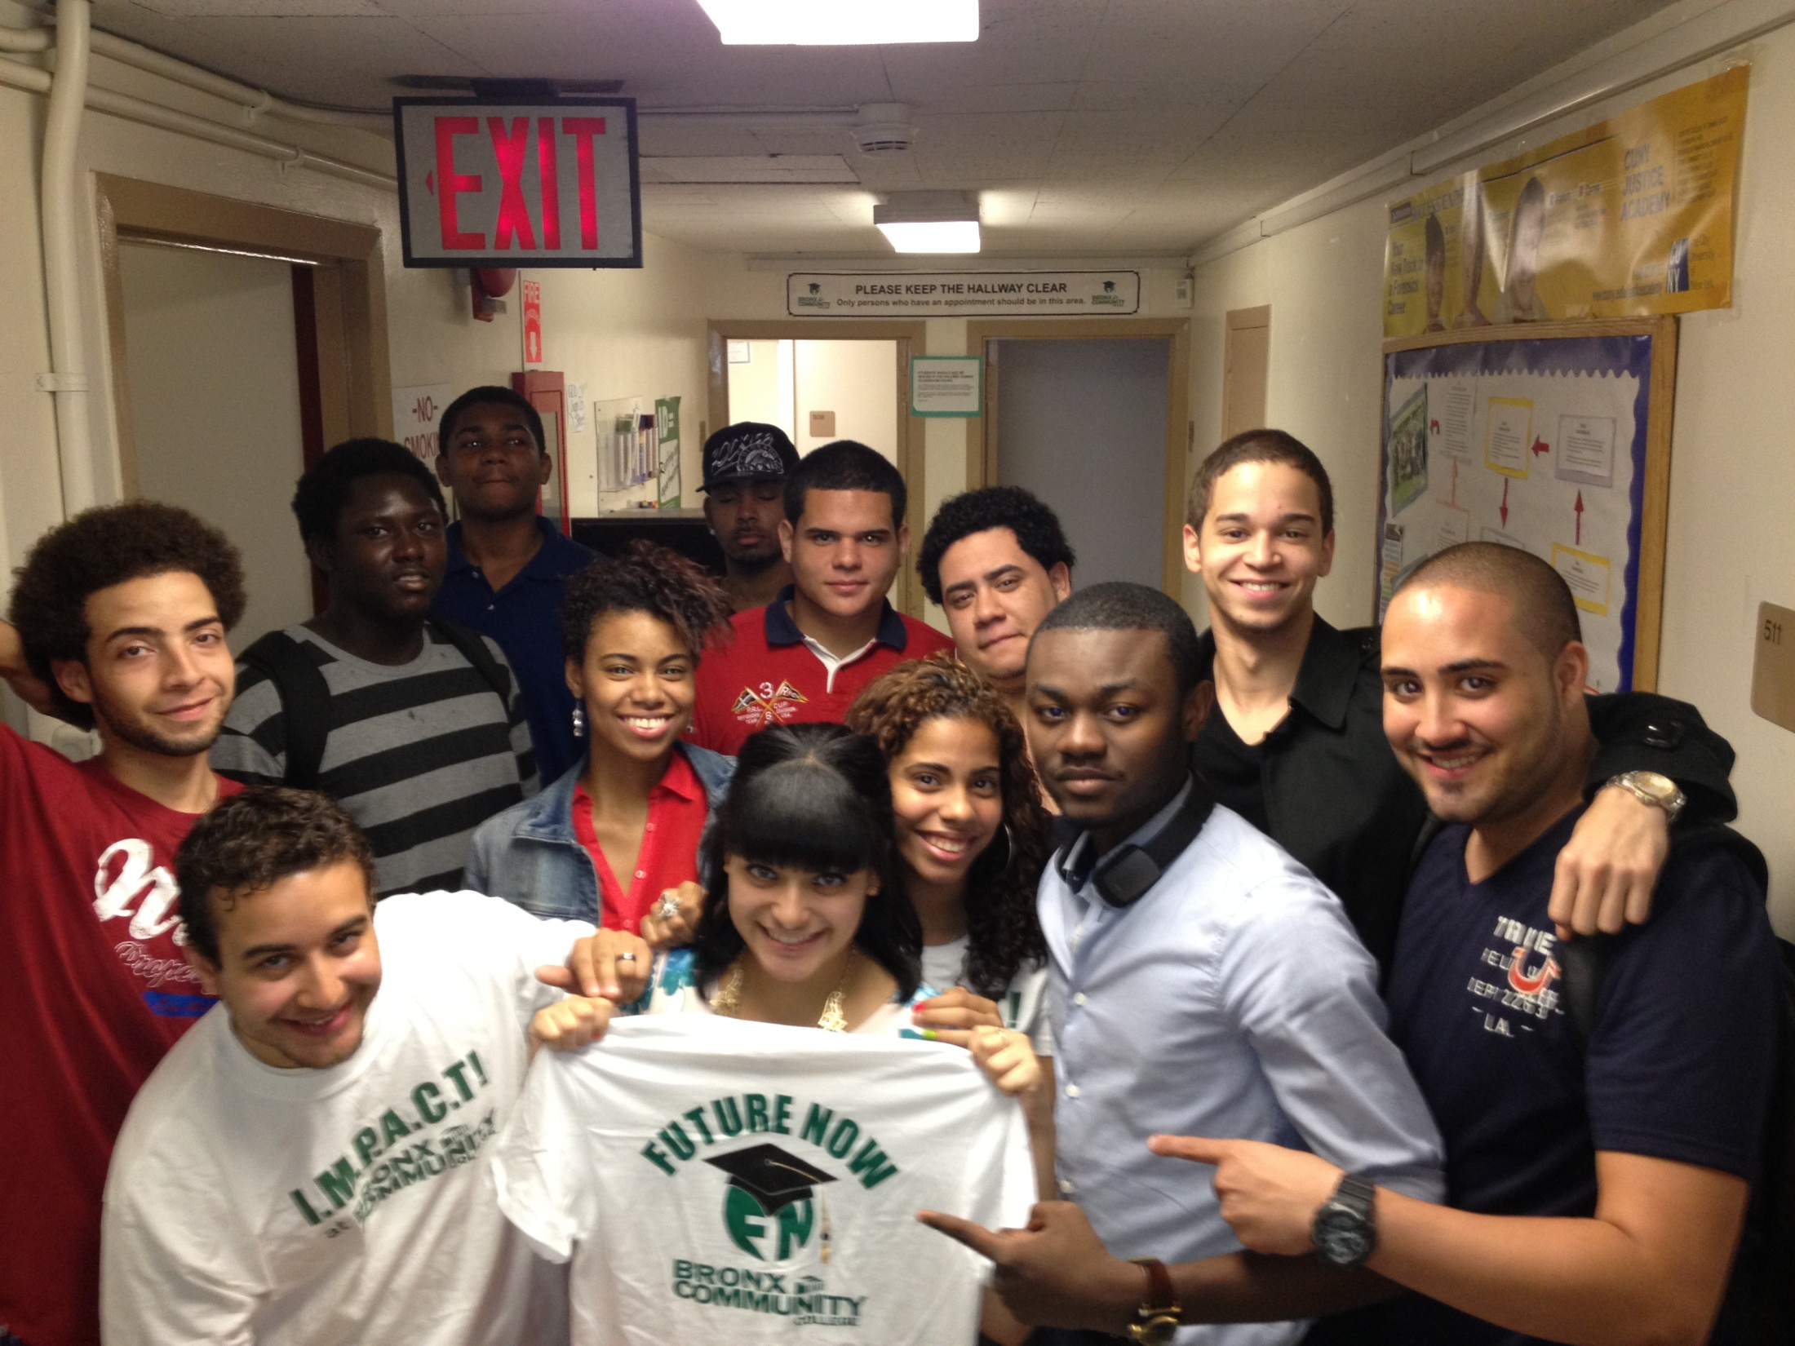

Future Now is a campus based GED prep and college completion program located at Bronx Community College

Slide 3
OUR MISSION
To empower out-of-school students
To assist students in completing their GED and transition into college
To help all students graduate in 3 years or less with an Associate’s Degree. Many transition to senior college
To develop students into self-sufficient leaders who will have a positive impact on their peers and the community at large

Slide 4
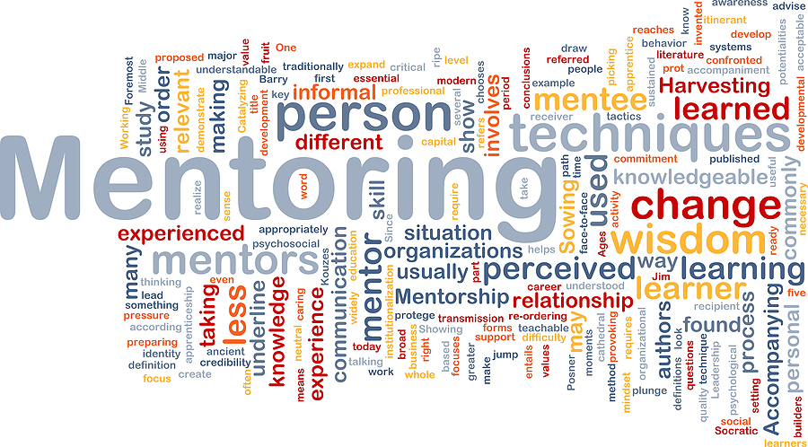
The Future Now / IMPACT Approach:
One-on-One, Group and Community Mentoring

Slide 5
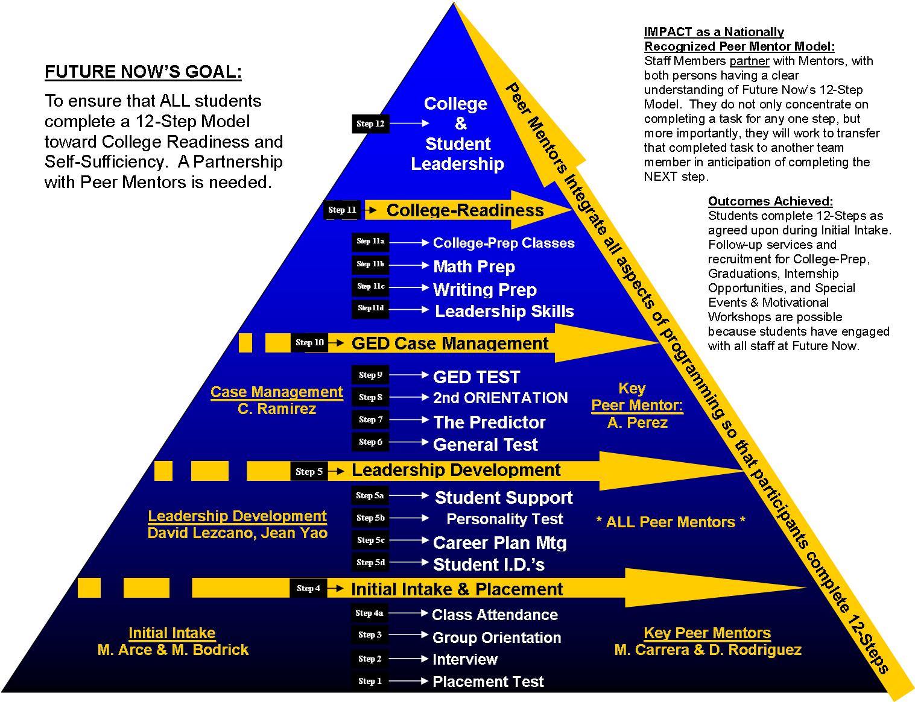
Future Now’s Goal:
To ensure that all students complete a 12 step model toward college readiness and self-sufficiency. A partnership with peer mentors is needed to achieve each step.
GED Coordinator
Peer
Mentors
College Coordinator
Peer Mentors
Intake Coordinator
Peer Mentors

Slide 6
OUR STUDENTS
Have all dropped out of high school - ages 17-25
TABE test at 8th grade reading level for GED classes
Over 50% of our students are court-involved
Many come from low-income single-parent families
Many are single parent themselves
Live in the west central Bronx, the home community of a large number of students at risk

Slide 7
FUTURE NOW / IMPACT OUTCOMES
  85% GED pass rates for all students enrolled
  95% college transition rates
  Three semester college retention rate of 67%
  Selected by NYC to pilot their model through the largest city funded project in the nation to improve outcomes for disenfranchised young men “The Young Men’s Initiative” (YMI)

Slide 8
THE IMPACT OF I.M.P.A.C.T!
(Before IMPACT)

Slide 9
The 3 C’s
Three pillars of resiliency:
Competence, Confidence and Connection

Slide 10
“Roots and Wings”
The Essential Building Blocks of Resilience*
Competence
Confidence
Connection
Character
Contribution
Coping
Control
Caring
*Taken from Building Resilience in Children and Teens
By Kenneth R. Ginsburg, MD, MS Ed, FAAP

Slide 11
BUILDING COMPETENCE
  High quality of academic preparation
  Tutoring provided by mentors
  Tutoring for college students
  College Prep taught by mentors

Slide 12
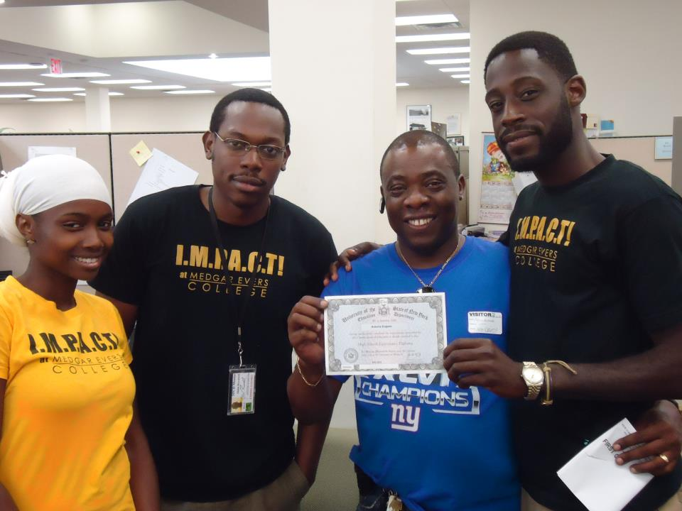
  Tutoring provided by mentors

Slide 13
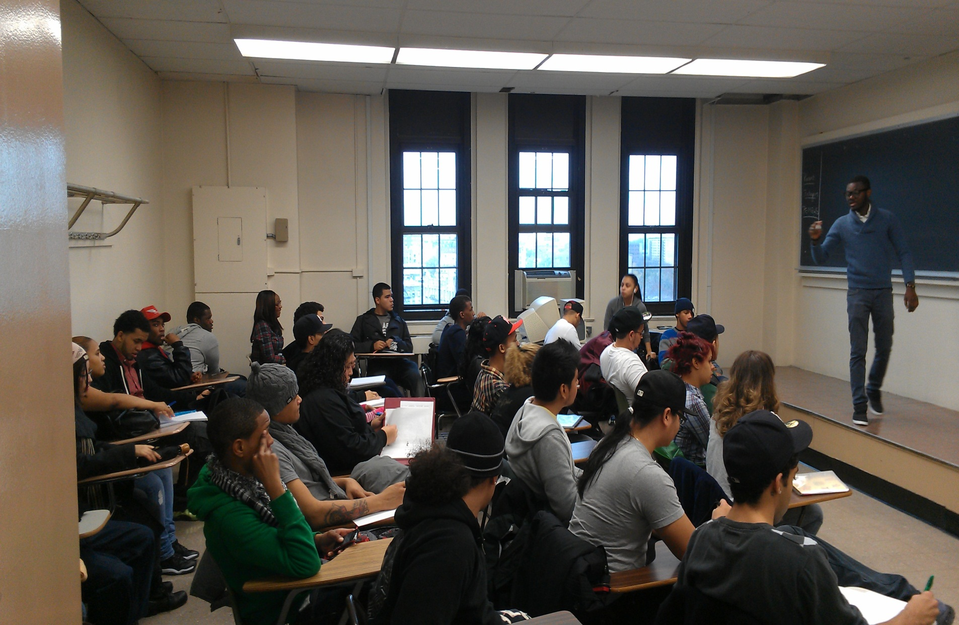
  COLLEGE PREP
  TAUGHT BY MENTORS

Slide 14
BUILDING CONFIDENCE
Leadership Development – Opportunities for meaningful contribution. Mentors are role models and living proof of success
Asset-Based Development – Build on strengths. 12 Step Model. Focus on the positive – glass half full
Listening exchange: We ask the students to identify their own TAGS- Talents, Assets, Gifts and Strengths
Build Self Awareness – Personality test (Myers Briggs) indentifies and matches strengths
Goal setting – ‘Career Planning Meetings’
Listen to students – Seek feedback and implement their ideas

Slide 15
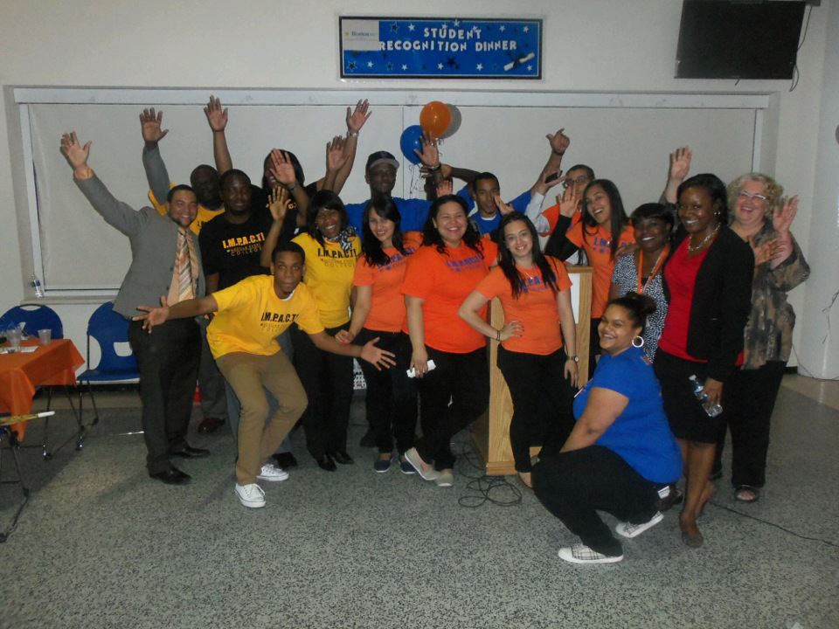
LIVING PROOF

Slide 16

Asset-Based Community Development:
12 Steps to Successful College Transition
Recruitment, Intake, & TABE Examination
Individual Interview
Program Orientation
Pre-GED / GED courses
Career Planning Meeting
Pass General Test
Pass Predictor and Take GED Exam
College Prep
Career Connection
Admissions and Financial Aid
Take College entrance exam
Advisement, Register and Validate Course

Slide 17



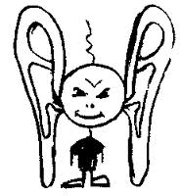

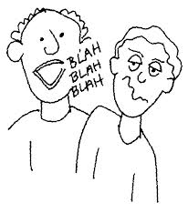

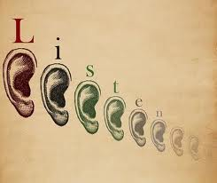
LISTENING EXCHANGE

Slide 18
BUILDING CONNECTION
Starts on Day 1: Build strong long-lasting relationships
Students form special bonds with the mentors/role models
Learn the students names, and give individual attention
Facebook (share pictures and important announcements), post pictures of GEDs, college degree, and other achievements
Events and Celebrations - Thanksgiving Luncheon, Christmas Celebration, Graduations
Students who graduate want to stay involved and ‘give back’ – volunteer, work-study, paid

Slide 19
CONNECTION VIA SOCIAL MEDIA
Future Now / IMPACT at Bronx Community College – Facebook
https://www.facebook.com/futurenowbcc
Future Now / IMPACT at Bronx Community College – YouTube Video
http://www.youtube.com/watch?v=yMotK4wpMRE
IMPACT at Hostos Community College – Facebook
https://www.facebook.com/impactat.hostos
IMPACT at Medgar Evers – Facebook
https://www.facebook.com/impact.atmec

Slide 20
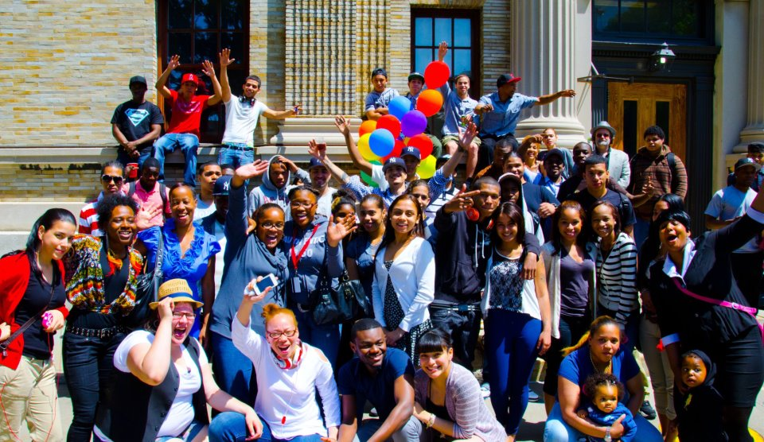
EVENTS & CELEBRATIONS

Slide 21
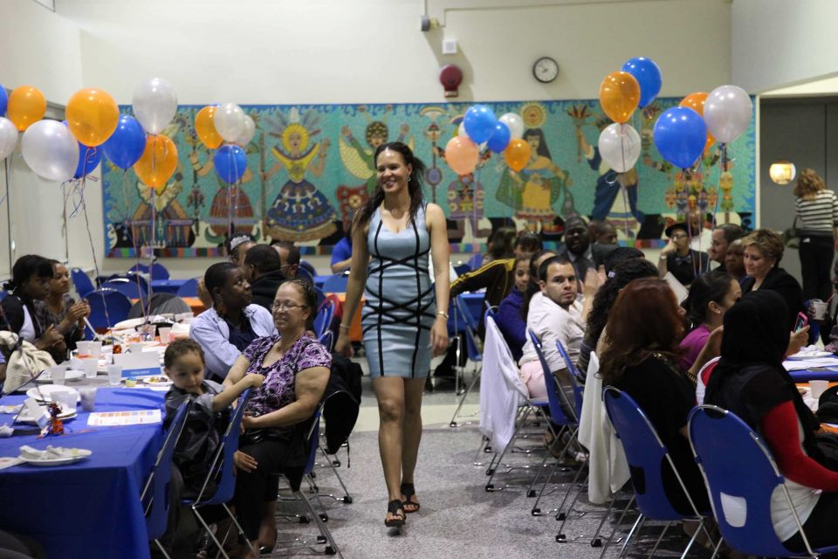
EVENTS & CELEBRATIONS

Slide 22
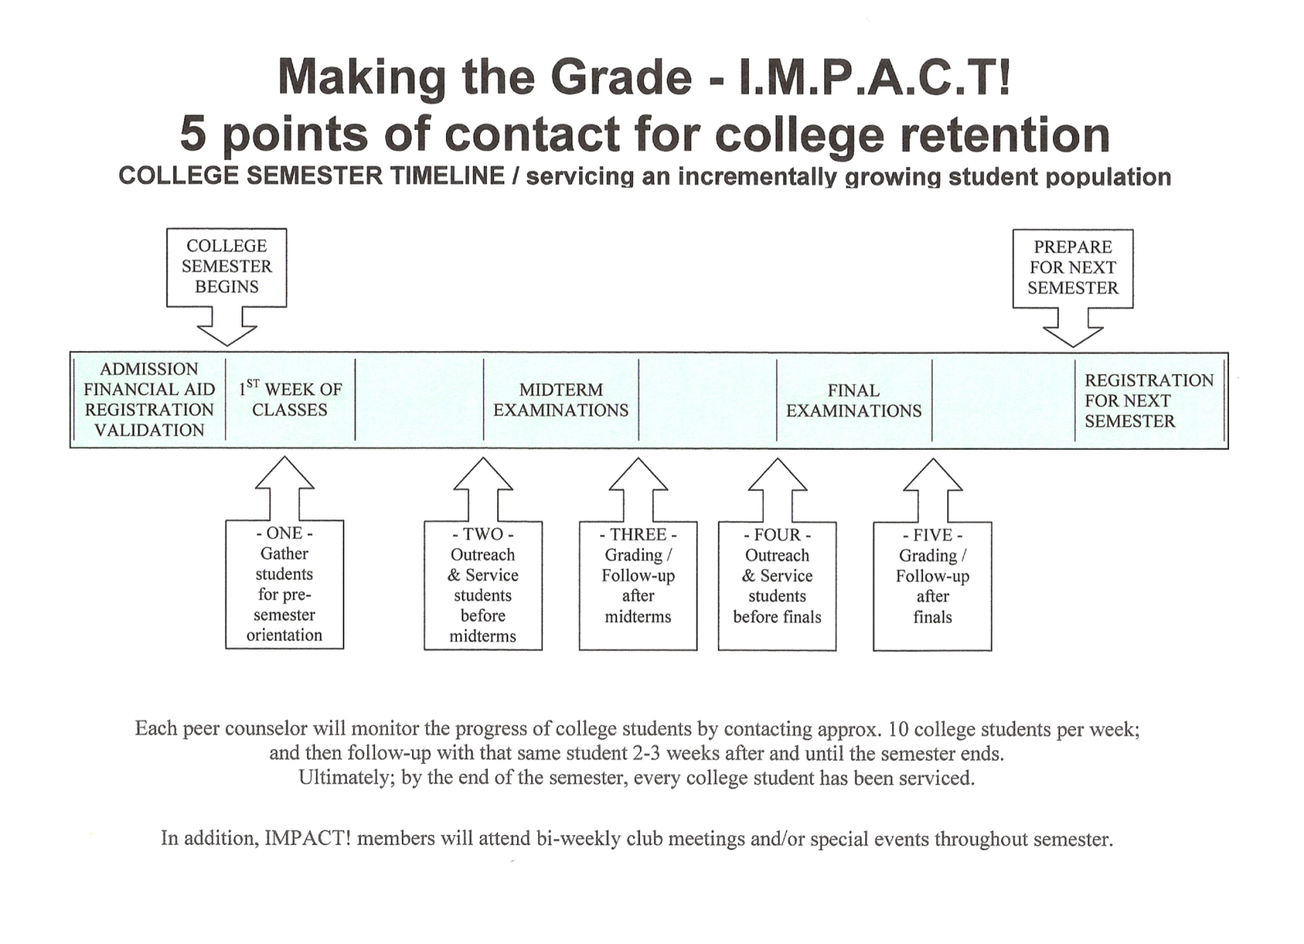

Slide 23
IMPACT Peer Mentoring:
A Promising Practice

Slide 24
ADAPTABLE & TRANSFERABLE MODEL
Win, Win, Win, Win
  Expands program capacities
  Improves program outcomes - GED, College transition, college completion
  Builds resilience and builds leaders
  Gives students work experience
A Virtuous Circle – benefits amplify over time
Soon to be added to NCTN Promising Practices website

Slide 25
NOT A MAGIC BULLET
& THE IMPORTANCE OF EVIDENCE
Takes some consistent and thoughtful resource
  IMPACT Coordinator to build up and support peer mentor program growth
  Staff and mentor support college prep and transition
  Work Study or stipends for mentors
Evidence-driven
  Collect good baseline data for comparison
  Determine the right metrics
Collect good data and evaluate to understand outcomes
Consistent learning and listening - Action Reflection model
Willingness to change program culture and practice
Learners seen as authentic partners

Slide 26
IMPACT PILOT
MEDGAR EVERS COLLEGE
HOSTOS COMMUNITY COLLEGE
Two campus-based pilot sites funded for 3 years via the Young Men’s Initiative
  Now in second semester of implementation
Targets are to significantly raise GED pass rates, college transition and persistence.
Even with short time frame have seen promising results

Slide 27










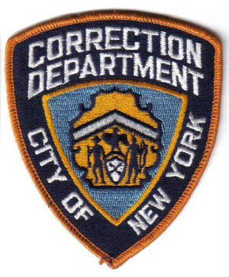





PARTNERSHIPS FOR SUCCESS
THANK YOU
The
Fortune Society

Slide 28
