Slide 1
NYREN As A Driver of Collective Impact: A Preliminary Analysis
Susan Sturm and Leah Pope
Center for Institutional and Social Change
at Columbia Law School
www.changecenter.org

Slide 2
Education and reentry: An inflection point
Shared vision and interests
Multi-level collaborators
Opportunities for action
Collective Impact

Slide 3
NYREN Mission: A Collective Impact Agenda
To enable people with criminal justice involvement to receive quality education appropriate to their needs so that they become fully engaged and productive members of their communities
To make education a core component of the reentry policy, strategy and practice in New York; and
To shift public priorities and resources from incarceration to educational access and success for communities affected by mass incarceration.

Slide 4
Barrier Analysis
Inadequate focus on education in reentry policy
Policy restrictions-Pell grants, teenagers as adults
Collateral consequences of conviction
Short term and “low horizon” orientation
Inadequate funding and prioritization of education
Lack of public understanding and responsibility
Ecosystem
Bureaucratic silos/agency fragmentation/turf
Cultural disconnects among organizations
Turnover
Incompatible information systems
Disconnect between service delivery and policy
Restrictive policies insensitive to reentry challenges
Limited communication
NETWORK
Institutional
Understaffed and overworked
Inadequate access to information and influence
Bureaucratic hurdles and boutique responses
Scramble and competition for resources and recognition
Gaps in necessary services
PROGRAM
Relational
Stereotyping by gatekeepers and employers
Family turmoil and peer pressure
Lack of mentors/supporters
Misinformation from the misinformed
Individual Level
Disconnection upon release
Lack of college knowledge
Gaps in educational prep
Learning disabilities
Homelessness, health, drug issues
Limited resources
Disbelief in possibilities

Slide 5
The need for collaboration across levels, organizations, and systems
People move from one system to the next (prison into community, GED into college)
People with criminal justice backgrounds must navigate requirements of multiple systems
Holistic support requires collaboration of diverse providers
Providers and policy makers must coordinate and align with those working in other organizations and systems.
Organizations and systems require change in culture, policy and practice to make education core
Collective action needed to make reentry education a public policy priority

Slide 6
What’s distinctive about NYREN’s collective impact approach
Education focus
Government, CBOs, Higher Ed
Building on shared commitments
Multiple hubs and connectors
Linking on-the-ground practice with concrete policy

Slide 7
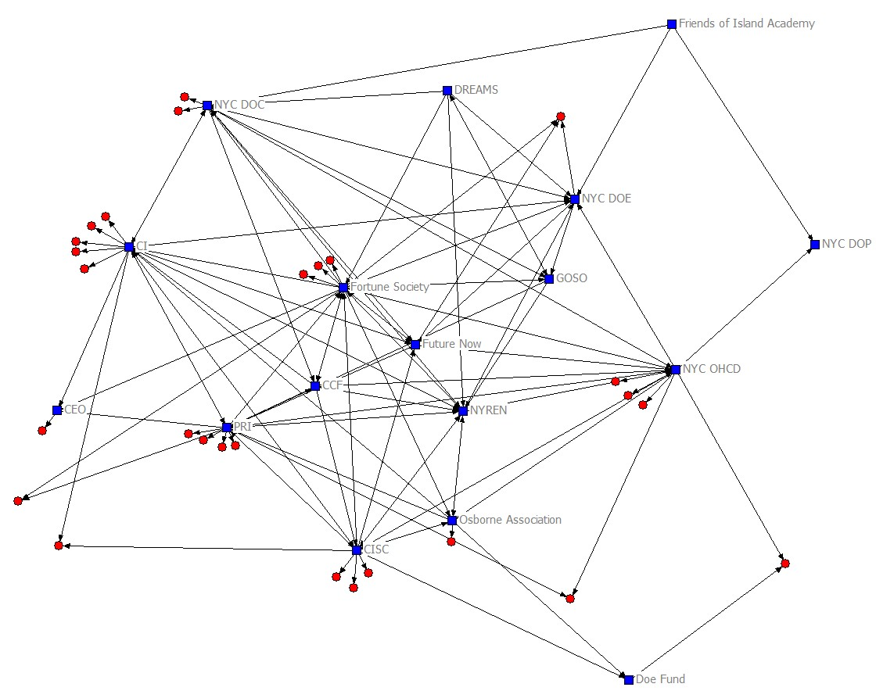
Organizational Relationships of NYREN

Slide 8
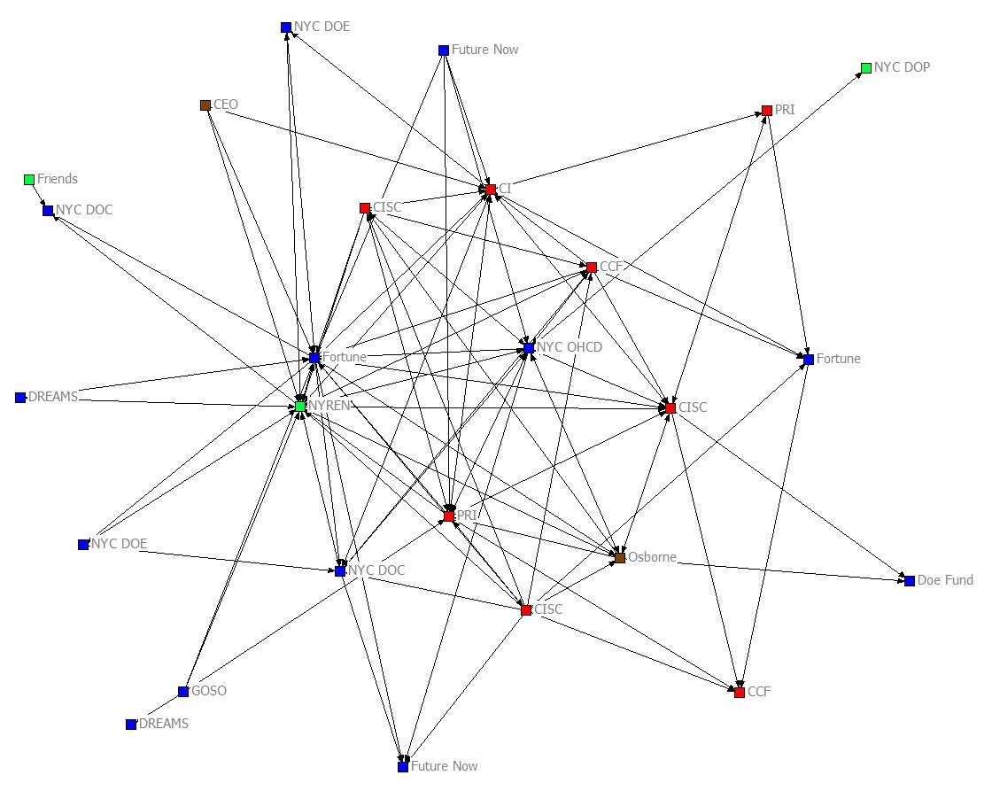
Overlapping Educational Arenas of NYREN

Slide 9
Strategically location of NYREN members
Areas of high need
4 of the 5 neighborhoods where the highest number of individuals return from prison
Geographic clusters
Harlem/Upper Manhattan
South Bronx
Neighborhoods where over 3200 people (27.5% of all individuals) returned from prison in 2008
Brownsville
Queens
Lower Manhattan/Downtown Brooklyn

Slide 10
Basic Literacy & Pre-GED
CASES
CEO
CUNY Catch
Doe Fund
Fortune
Friends
Future Now
Justice Corps
College Prep Classes
CASES
CUNY Catch
Future Now
College Initiative
GED Prep
CASES
CEO
CUNY Catch
Doe Fund
Fortune
Friends
GOSO
Justice Corps
Osborne
EDUCATIONAL
SERVICES

Slide 11
Peer Mentoring
CCF
College Initiative
Doe Fund
Friends
Future Now
Leadership Training
CASES
College Initiative
Doe Fund
CCF
CUNY Catch
Friends
Fortune
Justice Corps
PEER MENTORING &
LEADERSHIP DEVELOPMENT

Slide 12
Multiple collaboration and communication venues
Linked relationships
Coordinating and backbone roles
Listserve
Website
Monthly meetings
Working groups
Policy advocacy (members)
Collaboration with other networks
Conferences and public events

Slide 13
Collaboration Clusters
Start-up funding designed to facilitate collaboration
Collaborative hubs facilitating information sharing and collaboration
Partnerships between community based organizations and government agencies
Pilot projects to share information and data
Collaborative grant proposals and projects
Notes:
Mayor’s office bringing together CCF and CI –
Working on grants together – bringing together people and organizations with different strengths
Having this entity under which you had now 14 programs, maybe two years ago—12—whatever. Instead of saying oh here’s a program with Future Now, you could insert the network which then contained all of them and would by containing all of them also be relevant to so many more people’s transitions because any given person could be eligible or could fit for one of the 14 programs.
Housing/GED tests

Slide 14
Building a Learning Community
Trust building
Buttressing commitment
Targeting barriers
Developing a collective impact orientation
Sharing knowledge, tools, data, best practices
Notes:
you are working with a group of people that are kind of like tried and true and they’re backed by each other, it’s a win situation for you.
The man you saw at the beginning was not the same man that you saw the year after. I think he learned that through experience you know it's a major effort, a combined effort. You need the collaboration of the DOC, you know.
Education at the core
Change across levels and systems
Think systemic, act programmatic
Build trust, dispel stereotypes so that there can be effective collaborations and people will use each others’ services. (DOE, DOC, communtiy based organizations.
Because of the relationships that we’ve built with other organizations in the network—this large consortium of organizations—we’ve been able to find out about all the different activities that are taking place in the community around education. We’ve been able to e-mail staff for events.
It was definitely sort of tied in; the work was tied into the work that the wider network was doing, putting together this sort of the best practices guide, putting together the human resource list
all of a sudden there were tools and resources and things to go along with like well what is the network. You know so for us, that was a turning point in being able to actually utilize things about the network and the network without actually having to be at the table with the network
So to watch them start to trust and learn about each other and then collaborate that the first day would be like well my student. You know I had a student come out and then 12 months later, I mean we’re like, “Well I have this student; maybe you could help them with . . . because I can’t do that.” But before—they would like kind of hold them for themselves and to then see that people were starting to share students. And to maximize services for students, which for me I was like that’s great; that’s great; they’re actually working together.

Slide 15
Facilitating continuous communication and knowledge-sharing
About options and possibilities
Among people doing similar work
At critical times
Up and down levels
Across organizational lines
Notes:
What our district actually does is we serve populations to kind of keep them on track or to catch them like you know with the GED or help them find a different option. So that really is important for the network to have that information and that connection because where they might not be able to serve a student, we may be able to and vice-versa. Stacey
What is really happening? Is it working?

Slide 16
Collaboration and coordination to;
Facilitate transitions from one institution to another
Translate across systems and cultures
Coordinate services to provide holistic support
Cultivate leadership at all levels
Engage communities and families
Align policies to be mutually reinforcing
Learn from what works
Share and leverage resources
Undertake place-based transformation
Mobilize to make education more central and visible

Slide 17
Leveraging organizational catalysts
Katy Taylor
Tim Lisante
John Gordon
Ronald Day
Notes:
Four organizational catalysts on the panel to illustrate.
Service providers and community members on one level and policy makers on another.
Network – a core group of repeat players, who are themselves linked to others.
Working in different ways to enable relationships to develop and the information from these relationships to inform the work of people at higher and lower levels.
Organizational catalysts – people who work across many different systems and networks. Build relationships within network. Take lessons back to staff. To policy makers, to networks.
Bring insights into policy arena.

Slide 18
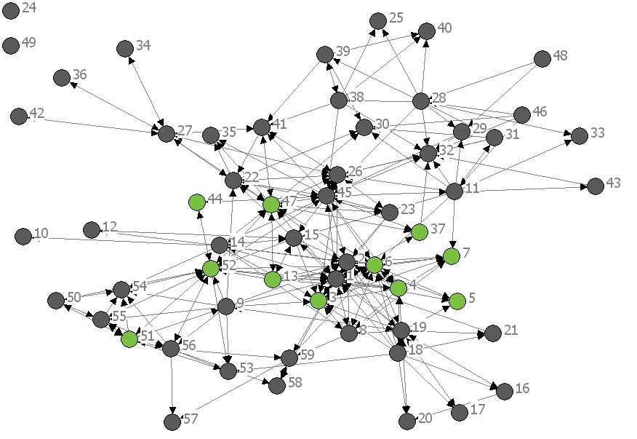
A Network of Organizational Catalysts
Roles operating at convergence of systems
Positioned to use knowledge where it can influence action
Translators, connectors, trust-builders, mobilizers
Have legitimacy and commitment
Speak multiple languages
Notes:
A group of people who are committed to these values and a position to take them on as a core part of the work.
Positioning you in this work.
Not a function of formal power, but of opportunities for influence at strategic locations.
You are organizational catalysts

Slide 19
Moving toward collaboration
Providers used to compete against one another. They did not used to support one another. They did not used to communicate. They were too worried about their own agenda.
That’s not the case anymore. They are now sending emails to one another: “Look, I have a GED next week. If I have room.” That never happened, not even five years ago. It was each on their own and for their own. . . .I really think they don’t realize how much sharing, how much uniformity they’ve developed as a result of the Reentry Education Network.

Slide 20
The Next Phase for
Collective Impact:
Ecosystem
NETWORK
Institutional
NYREN
PROGRAM
Relational
Individual Level

